Slide 1
Metatitans
Aadil Anthrollil Abu- 245268
Christo Shaji-245052
Meera Javad-245217
Swetha S-245154

Slide 2
Space Complexity
March 3,2023
Christo Shaji
245052

Slide 3
Introduction
•Space complexity is nothing but the amount of memory space that an algorithm or a problem takes during the execution of that particular problem/algorithm.
•Auxiliary space is the space required by an algorithm/problem during the execution of that algorithm/problem and it is not equal to the space complexity because space complexity includes space for input values along with it also.
•Space Complexity = Auxiliary Space + Space used for input values
•Space complexity of an algorithm is commonly expressed using Big O (O(n)) notation.

Slide 4
Need To Calculate Space Complexity
Calculation and analyzing of this space complexity is important because in real world applications developers are bounded/limited to acquire the memory in the devices.
If an algorithm takes up a lot of time, you can still wait, run/execute it to get the desired output. But, if a program takes up a lot of memory space, the compiler will not let you run it.
An algorithm is sufficient when the algorithm is solving the problem in less amount of time while taking the least amount of space.

Slide 5
Types of space complexities:
1. Constant Space Complexity: If the amount of memory used by the algorithm is independent of the input size. For example, an algorithm that sorts an array in place has a constant space complexity of O(1).
2. Linear Space Complexity: If the amount of memory used by the algorithm is proportional to the input size. For example, an algorithm that creates an array of n elements has a linear space complexity of O(n).
3. Quadratic Space Complexity: If the amount of memory used by the algorithm is proportional to the square of the input size. For example, an algorithm that creates a two-dimensional array of size n x n has a quadratic space complexity of O(n^2).
4. Exponential Space Complexity: If the amount of memory used by the algorithm grows exponentially with the input size. For example, an algorithm that generates all subsets of a set of n elements has an exponential space complexity of O(2^n).

Slide 6
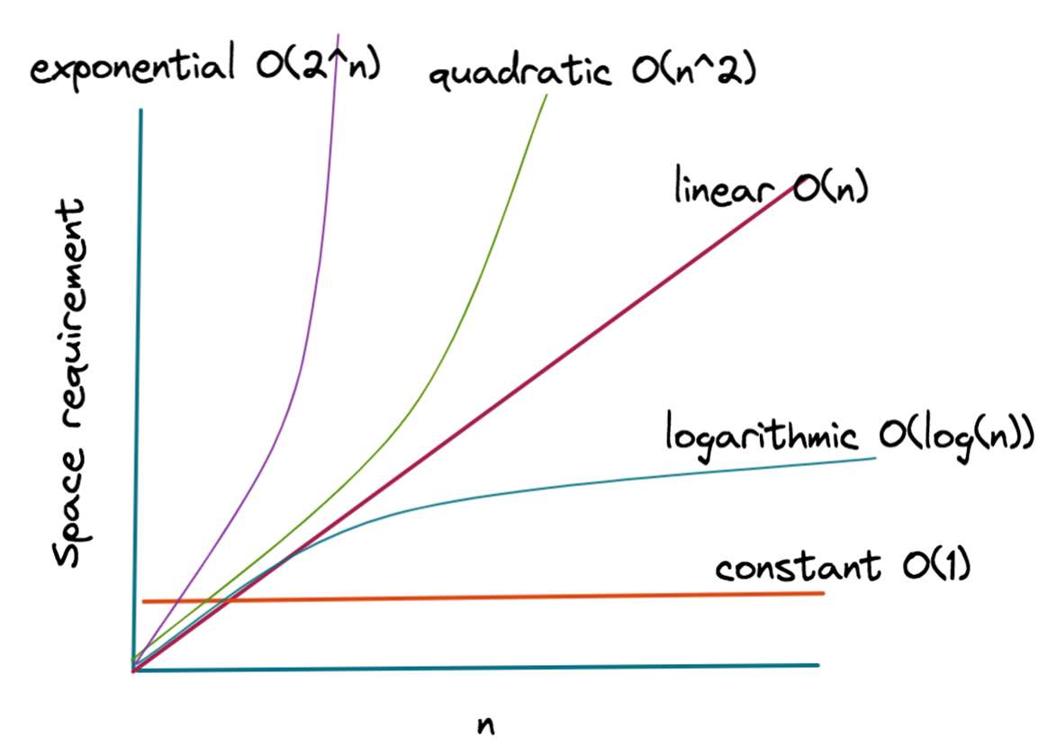
Graphical representation of various space complexities

Slide 7
How To Evaluate Space Complexity
•Identify the variables and data structures used by the algorithm
•Determine the space requirements of each variable and data structure
•Count the number of times each variable or data structure is used
•Sum up the space requirements of all variables and data structures:
Determine the auxiliary space of the algorithm.
•Finally, express the space complexity as a function of the input size.
•This is usually done using big O notation, which gives an upper bound on the space requirements of the algorithm as the input size grows.

Slide 8
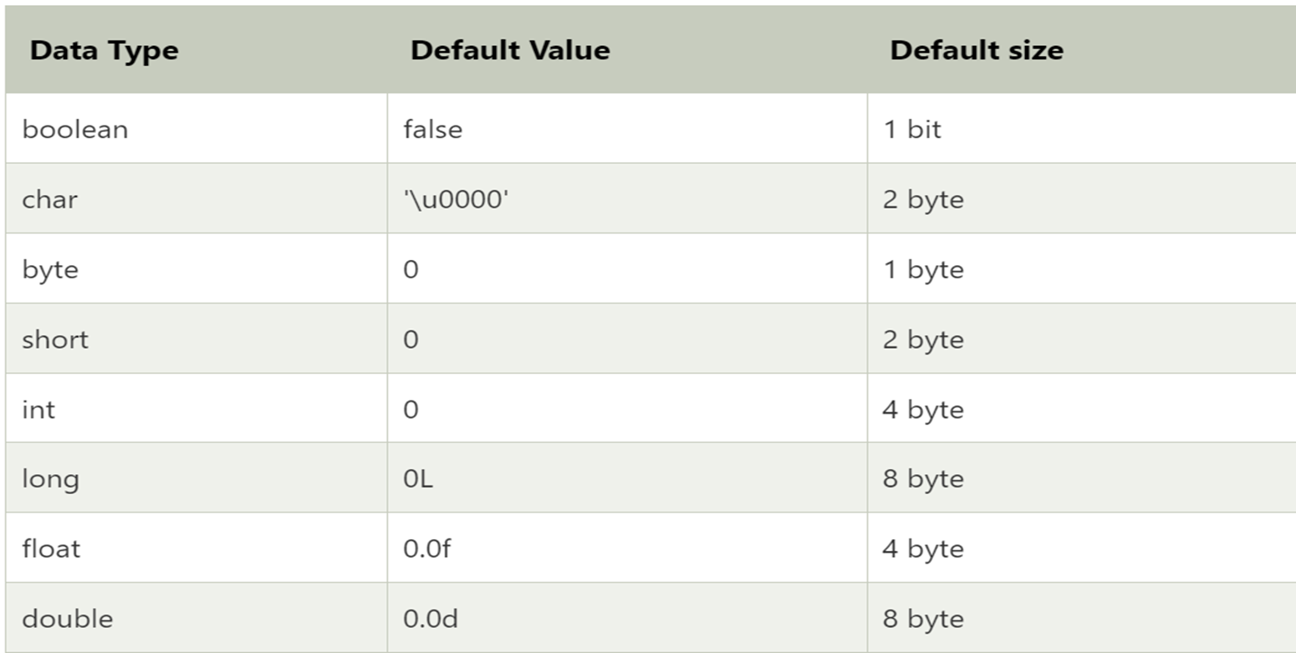
The following chart shows the default size of various data types used in java

Slide 9
Example 1: Factorial of a Number(Iterative)
"fact" is an integer variable which will store the factorial of the number(N), as a variable fact will take the "4 bytes" of space.
"N" is an integer variable which stores the value for which we have to find the factorial, so no matter what value will, it will just take "4 bytes" of space.
"i" is an iterator variable which stores the current value of iteration, so it will also take "4 bytes" of space.
Now function call, initializing for loop and return function these all comes under the auxiliary space and lets assume these all will take combinedly “4 bytes” of space.
Hence, Total Space Complexity = 4*4=16 bytes
As there is no variable which just constant value(16) is there so it means that this algorithm will take constant space that is "O(1)".
factorial(N){
int fact=1;
for (int i=1; i<=N; i++)
{
fact*=i;
}
return fact;
}

Slide 10
Example 2: Factorial of a number(Recursive)
Now "N" is an integer variable which stores the value for which we have to find the factorial, so no matter what value will, it will just take "4 bytes" of space.
Now function call, "if" condition, "else" condition, and return function these all comes under the auxiliary space and lets assume these all will take combinedly “4 bytes” of space.
But the matter of fact here is that here we are calling that function recursively "N" times so here the complexity of auxiliary space will be "4*N bytes" where N is the number of which factorial have to be found.
Hence, Total Space Complexity = (4 + 4*N) bytes But these 4 bytes are constant so we will not consider it and after removing all the constants(4 from 4*N) we can finally say that this algo have a complexity of "O(N)".
factorial(N){
if(N<=1)
{
return 1;
}
else
{
return (N*factorial(N-1));
}
}

Slide 11
Conclusion
Creators of real-world programs are constrained by the physical memory of the platforms they plan to run on. That's where space complexity comes into play, as its obvious that we never ever want to run a function or process that consumes more space than the system has available at any one time.
Helps to find to out the most optimized algorithm among all the algorithms, for particular type of problem.
The best algorithm/program should have the least space-complexity. The lesser the space used, the faster it executes.
After completing your program always analyze the worst-case scenario so that it can handle the large inputs and can have high adaptability and supportability.

Slide 12
Time complexity
March 3, 2023
Aadil Anthrollil Abu
245268

Slide 13
Introduction
Time complexity is a measure of how long an algorithm takes to run as the size of its input increases.
The time complexity of an algorithm can be expressed using the big O notation
Understanding time complexity is essential for developing efficient and scalable Java programs

Slide 14
Big O notation
The big O notation is a mathematical notation used to describe the upper bound of an algorithm's time complexity.
It represents the worst-case scenario for the algorithm's performance as the size of the input increases.
The notation is read as "big O of" and the algorithm's time complexity expression.
The most common time complexity classes in big O notation are O(1), O(n), O(log n), O(n^2), and O(2^n).

Slide 15
Example of time complexity in java
O(1): constant time complexity, where the algorithm's runtime remains the same regardless of the input size.
Example: accessing an element in an array by index, performing a single arithmetic operation.
O(n): linear time complexity, where the algorithm's runtime increases linearly with the input size.
Example: iterating through an array or a list, performing a linear search.

Slide 16
Example of time complexity in java
O(log n): logarithmic time complexity, where the algorithm's runtime increases logarithmically with the input size.
Example: performing a binary search on a sorted array.
O(n^2): quadratic time complexity, where the algorithm's runtime increases quadratically with the input size.
Example: nested loops iterating through an array or a matrix.

Slide 17
Example of time complexity in java
O(log n): logarithmic time complexity, where the algorithm's runtime increases logarithmically with the input size.
Example: performing a binary search on a sorted array.
O(n^2): quadratic time complexity, where the algorithm's runtime increases quadratically with the input size.
Example: nested loops iterating through an array or a matrix.

Slide 18
How to calculate time complexity in java
Identify the algorithm
Count the operations
Determine the input size
Express the time complexity

Slide 19
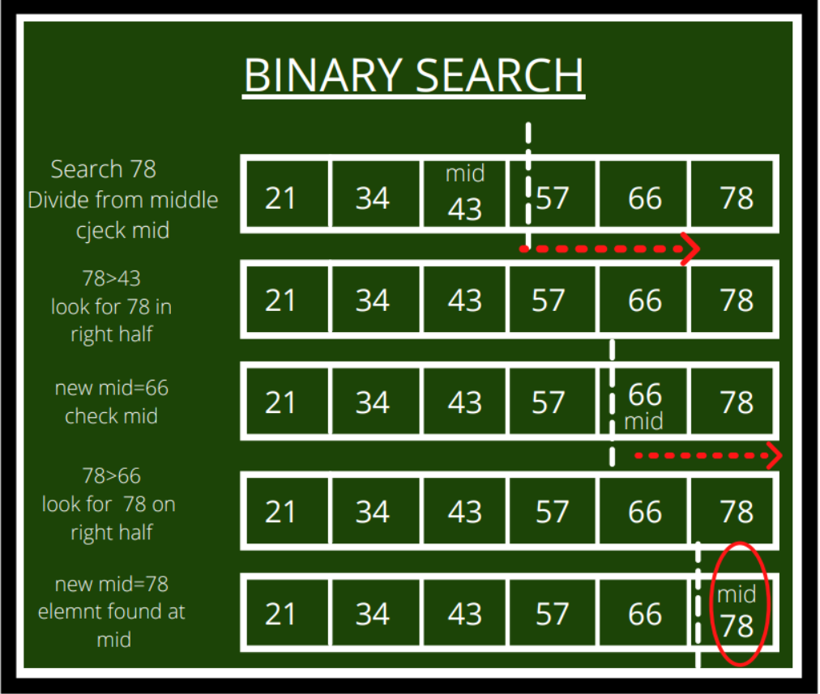
Calculate time complexity of Binary search
Comparing the target value to the middle element of the array
Dividing the search interval in half
Checking if the target value has been found

Slide 20
Best practices
Choose algorithms and data structures with lower time complexity to improve performance.
Be mindful of the time complexity of the algorithms and data structures used in your code.
Use benchmarking and profiling tools to measure the performance of your code and identify bottlenecks.
Optimize performance by reducing unnecessary operations, caching results, and parallelizing tasks.

Slide 21
Conclusion
Time complexity is an essential concept in computer science and programming, especially in Java.
By understanding time complexity, you can develop more efficient and scalable Java programs.
Remember to choose algorithms and data structures with lower time complexity, measure your code's performance, and optimize it for better performance.

Slide 22
IMMUTABLE OBJECTS
March 3, 2023
Swetha S
245154

Slide 23
IMMUTABLE OBJECTS
In object-oriented programming and functional programming, an immutable object (unchangeable object) is an object whose state cannot be modified after it is created.
This contrasts with a mutable object(changeable object), which can be modified after it is created.

Slide 24
EXAMPLES OF IMMUTABLE OBJECTS
String : Once a string object is created, it’s value cannot be changed.
Tuple : A tuple is a collection of objects that cannot be modified after creation.
Primitive objects such as int, long, float, double.

Slide 25
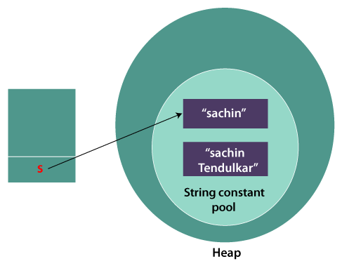
String
String s = “Hello”;
s.concat(”world”);
System.out.println(s);
Output : Hello
-----------------------------------------------------------------------
String s = “Hello”;
String s1=s.concat(”world”);
System.out.println(s1);
Output : Helloworld
Hello
Helloworld

Slide 26
WHY IMMUTABLE OBJECTS
02

Slide 27
BENEFITS OF IMMUTABLE OBJECTS
Thread safety : Immutable objects can be safely shared between multiple threads without fear of race conditions or synchronization issues.
Hashability : Immutable objects can be used as keys in hash tables because their hash value remains constant throughout their lifetime.
Simplified code : Immutable objects eliminate the need to write defensive or protective code to ensure that objects are not modified after creation.
Security : Immutable objects cannot be modified, so they are less vulnerable to security attacks that try to modify objects in unexpected ways.

Slide 28
IMPLEMENTING IMMUTABLE OBJECTS
To create an immutable object, the object’s state must be initialized, and the constructor and all fields must be marked as final.
Any methods that change the state of objects should return a new object instead of modifying the existing one.

Slide 29
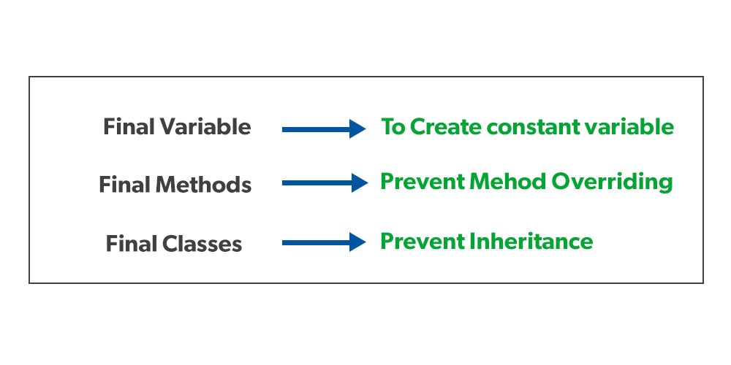
THE FINAL KEYWORD
variables are mutable by default, meaning we can change the value they hold.
By using the final keyword when declaring a variable, the Java compiler won't let us change the value of that variable. Instead, it will report a compile-time error:
final keyword is used in different contexts.

Slide 30
IMMUTABLE CLASS
The following things are essential for creating an immutable class:
Final class, which is declared as final so that it can't be extended.
All fields should be private so that direct access to the fields is blocked.
No Setters
All mutable fields should be as final so that they can not be altered once initialized.

Slide 31
IMMUTABLE CLASS EXAMPLE
public final class Person {
private final String name; private final int age; public Person(String name, int age) { this.name = name; this.age = age; } public String getName() { return name; } public int getAge() { return age; } }
Person person = new Person("Alice", 30);
System.out.println(person.getName()); //Output: Alice System.out.println(person.getAge()); // Output: 30

Slide 32
CONCLUSION
Immutable objects are useful in programming because they simplify code, provide thread safety and allow objects to be used in hash tables.
By making fields as final and creating methods that return new objects instead of modifying existing ones, developers can create their own immutable objects.

Slide 33
STRINGS IN JAVA
March 3, 2023
Meera Javad
245217

Slide 34
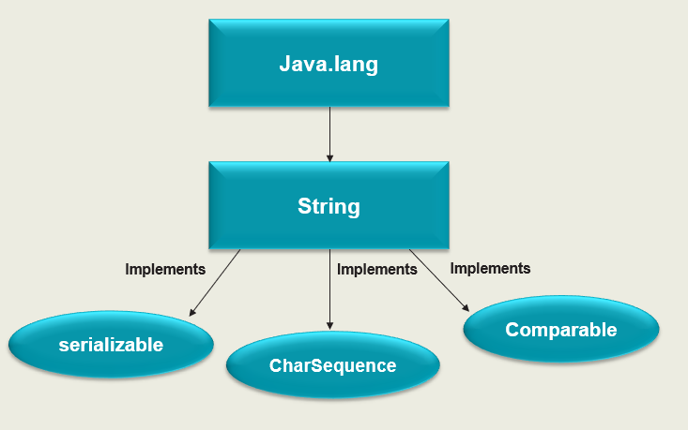
STRINGS
In Java, string is basically an object that represents sequence of char values.
Example: String message =“Hello World!”;
System.out.println(message);

Slide 35
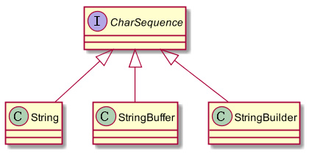
The java.lang.String class is used to create a string object.
There are two ways to create a string object:
String literal: String s=“computer";
New Keyword: String s=new String("Welcome");

Slide 36
Immutable String in Java
In Java, String objects are immutable.
String s="Sachin";
s.concat(“Tendulkar”);
String s="Sachin";
s=s.concat(" Tendulkar");

Slide 37
Why String objects are immutable in Java?
1.CLASSLOADER
2.THREADSAFE
3.HEAPSPACE

Slide 38
STRING OPERATIONS IN JAVA
Some of the Java string operations are:
compareTo()
concat()
equals()
length()
replace()
substring()
charAt()
contains()

Slide 39
1.compareTo()
If s1 > s2
If s1 < s2,
If s1 == s2
It returns positive number
It returns negative number
It returns 0
Syntax:
public int compareTo(String anotherString)
2.charAt()
The Java String class charAt() method returns a char value at the given index number.
The index number starts from 0 and goes to n-1, where n is the length of the string
Syntax:
public char charAt(int index)

Slide 40
3.concat()
The Java String class concat() method combines specified string at the end of this string.
Syntax:
public String concat(String anotherString)
Example: String s = "Hello ";
s = s.concat("World");
Output: Hello world
4.equals()
The Java String class equals() method compares the two given strings based on the content of the string.
Syntax:
publicboolean equals(Object anotherObject)
Example: String s1="javatpoint“ ;
String s4="python";
System.out.println(s1.equals(s4));//false

Slide 41
5.contains() The Java String class contains() method searches the sequence of characters in this string. Syntax: public boolean contains(CharSequence sequence) Example: String name="what do you know about me"; System.out.println(name.contains("do you know")) 6.length() The Java String class length() method finds the length of a string. Syntax: public int length() Example: String s1="javatpoint"; System.out.println("string length is: "+s1.length()); .

Slide 42
7.replace()
The Java String class replace() method returns a string replacing all the old char or CharSequence to new char or CharSequence.
Syntax:
public String replace(char oldChar, char newChar)
Example: String s1=“computer”
String replaceString=s1.replace(‘u',’e’)
System.out.println(replaceString); //”competer”
8.substring()
The Java String class substring() method returns a part of the string.
Syntax:
public String substring(int startIndex, int endIndex)
Example: String s1=“playstation";
String substr2 = s1.substring(4,11)
System.out.println(substr2); station //

